Slide 1
SUPERSTORE SALES DASHBOARD
USING POWER BI
CONCLUSION
ADVANCEMENTS
DASHBOARD
DASHBOARD
DATASET
INTRODUCTION
Presented by:
GROUP - 01
Akshitha Pothula
Gautham Sai
Ankur Nayak
Dipali Badgajur
Siva Naga Jyothi

Slide 2


Power BI is a powerful business analytics tool by Microsoft that enables users to visualize data, create interactive dashboards, and generate insights. It simplifies data analysis and sharing, empowering better decision-making across organizations. And Excel is used for initial data cleaning and preparation.
Analyze and visualize the Superstore Sales dataset to extract valuable insights on sales performance, regional trends and product segments.
Primary audience are Business stakeholders and Sales team who requested the data-driven insights for decision-making.
CONCLUSION
INTRODUCTION
ADVANCEMENTS
DASHBOARD
DASHBOARD
DATASET

Slide 3
The dataset consists of 20 columns, each containing specific information about sales transactions.
Category: Represents the product category (e.g., Electronics, Furniture).
City: The city where the customer is located.
Country: The country of the customer.
Customer Name: Name of the customer.
Discount: The discount applied to the product.
Order Date: The date when the order was placed.
Order ID, Product ID & Customer ID : A unique identifier for each order, product and customer.
Product Name: Name of the product purchased.
Postal Code: The postal code of the customer's location.
Quantity: The number of items ordered.
Region: The region within the country where the customer resides.
Sales Price: The price at which the product is sold before any discount.
Segment: The customer segment (Consumer, Corporate).
Ship Date & Ship Mode : The date the order was shipped and method used (Standard, Express).
Ship Mode: The method used to ship the order (Standard, Express).
Sub-category: A product classification within main category (Office Chairs within Furniture).
Turnover: Total revenue or sales generated by the order.
CONCLUSION
INTRODUCTION
ADVANCEMENTS
DASHBOARD
DASHBOARD
DATASET

Slide 4
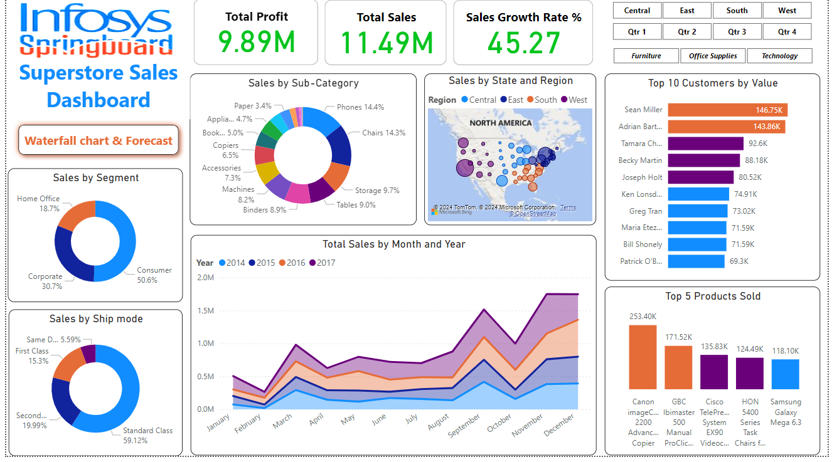
CONCLUSION
INTRODUCTION
ADVANCEMENTS
DASHBOARD
DASHBOARD
DATASET

Slide 5
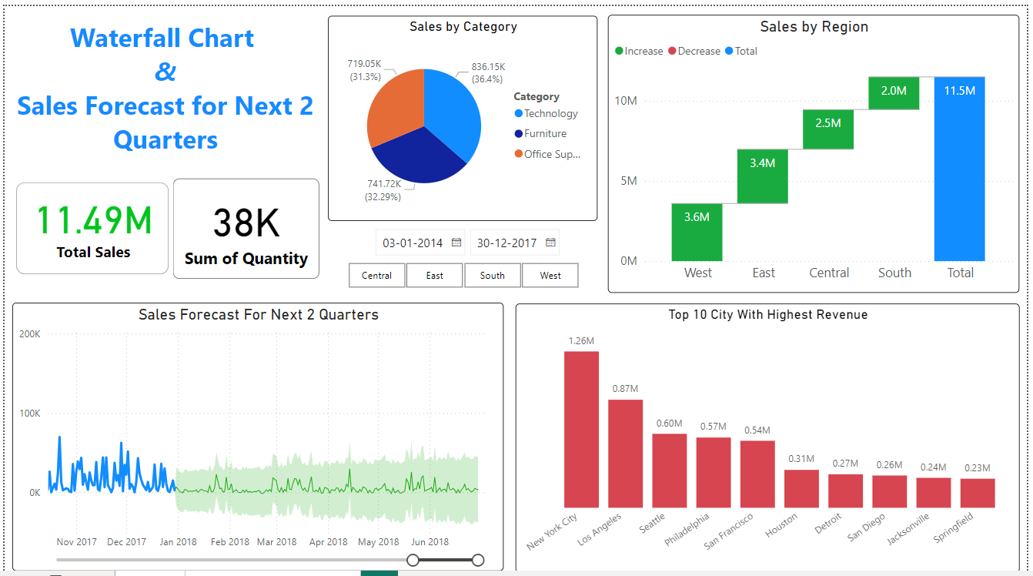
CONCLUSION
INTRODUCTION
ADVANCEMENTS
DASHBOARD
DASHBOARD
DATASET

Slide 6
Future Advancements:
Advanced Analytics and Predictive Modelling
Sales Forecasting
Customer Segmentation with Machine Learning
Enhanced Data Integration
Incorporating Additional Datasets
Cross-Departmental Data
Real-Time Data Analysis
Real-Time Dashboarding
Automated Alerts
Deep Dive into Profitability Analysis
Cost Analysis for Profit Optimization
Product Life Cycle Analysis
Improved Customer Experience Insights
Customer Feedback Integration
Predicting Customer Churn
CONCLUSION
ADVANCEMENTS
INTRODUCTION
DASHBOARD
DASHBOARD
DATASET

Slide 7
The analysis shows regional and product category differences in sales performance. The West and East regions are the most robust performers, with the Central and South regions showing growth potential. The key is to tailor offerings and promotions to the preferences of consumers.
This analysis of lower sales in the Home Office segment may offer opportunities for expansion. High sales growth rates along with peak periods in certain months indicate seasonal trends, which seem to be in tune with marketing strategies. For instance, the top product categories, Technology and Furniture, have strong customer demand, while Office Supplies require focused promotion or new products to upgrade the supply.
Optimizing shipping methods and deploying incentives for faster delivery may better enhance customer satisfaction.
CONCLUSION
INTRODUCTION
ADVANCEMENTS
DASHBOARD
DASHBOARD
DATASET
THANK YOU

